Slide 1

Systems analysis activities
Modeling requirements
Viet-Trung Tran
trungtv.github.io
School of Information and Communication Technology

Slide 2
Outline

Slide 3
Use cases
Use case is an activity that the system performs in response to a request by the user (or an agent)
Two techniques for developing use cases
User Goal Technique
Event Decomposition

Slide 4
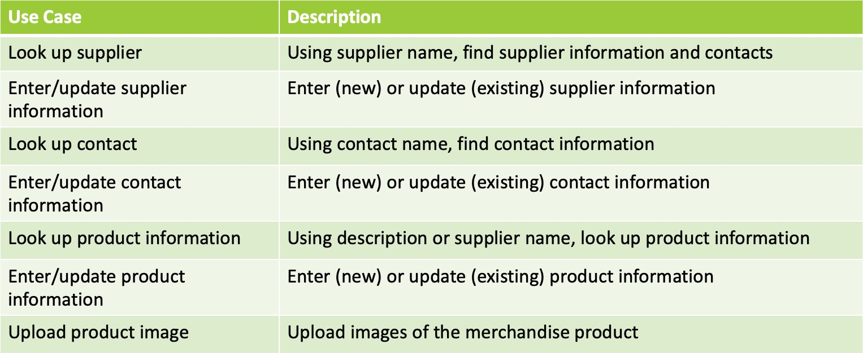
Use Case Examples

Slide 5
User Goal Technique
Identify all users
Classify all users in terms of their functional role
Classify all users by organizational level
Interview all users (or all types)
what are their specific goals?
frame all in imperative verb-noun format
Update order
Add customer
Create a list of use cases, organized by type of user
Look for duplicates, resolve inconsistencies
Identify where different users have the same use case
Review updated list with users and stakeholders

Slide 6
Event Decomposition Technique
Identify use cases based on business events the system must handle and respond to
Easier said than done
Identifying the events that are associated with use cases at the right level of detail is difficult
Example
enter a name on a form
add a new customer to the system
add customers and update customer records
Which is best level of detail?

Slide 7
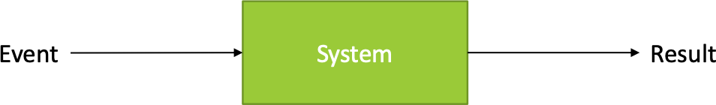
Event Decomposition
The right level of detail corresponds to a task
That is performed by one person
adds measurable business value
leaves the system and data in a stable state
We call this: Elementary Business Process (EBP)
Fill a shopping cart: Is this a EBP?
Ask ourselves
What business events happen that the system will need to respond to?

Slide 8
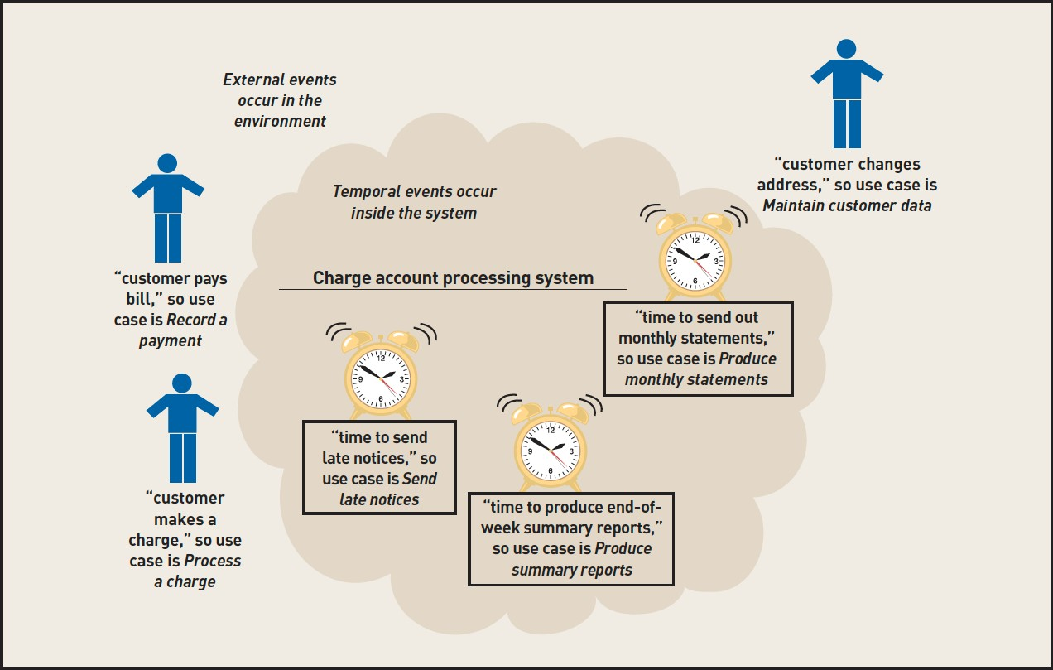

Slide 9
Three Events:
Customer pays a bill
Customer makes a charge
Customer changes their address

Slide 10
Three Use Cases:
Record a payment
Process a change
Maintain customer

Slide 11
Three Temporal Events:
Time to send late notices
Time to send out monthly statements
Time to produce end of week
summary reports

Slide 12
Three Use Cases:
Send late notices
Produce monthly statements
Produce summary reports

Slide 13
Types of Events
External events
can also be triggered by employees or departments
Checklist
external agent wants something, that results in a transaction
external agent wants some information
data changed, and needs to be updated
management wants some information Temporal Events State Events
External events to look for include:
External agent wants something resulting in a transaction
External agent wants some information
Data changed and needs to be updated
Management wants some information

Slide 14
Temporal events
An event that occurs as a result of reaching a point in time
Ask:
What deadlines occur?
What outputs are associated with those deadlines?
Temporal events to look for include:
Internal outputs needed
Management reports (summary or exception)
Operational reports (detailed transactions)
Internal statements and documents (including payroll)
External outputs needed
Statements, status reports, bills, reminders

Slide 15
State events
an event that occurs when something happens inside the system that triggers the need for processing (also called internal events)

Slide 16
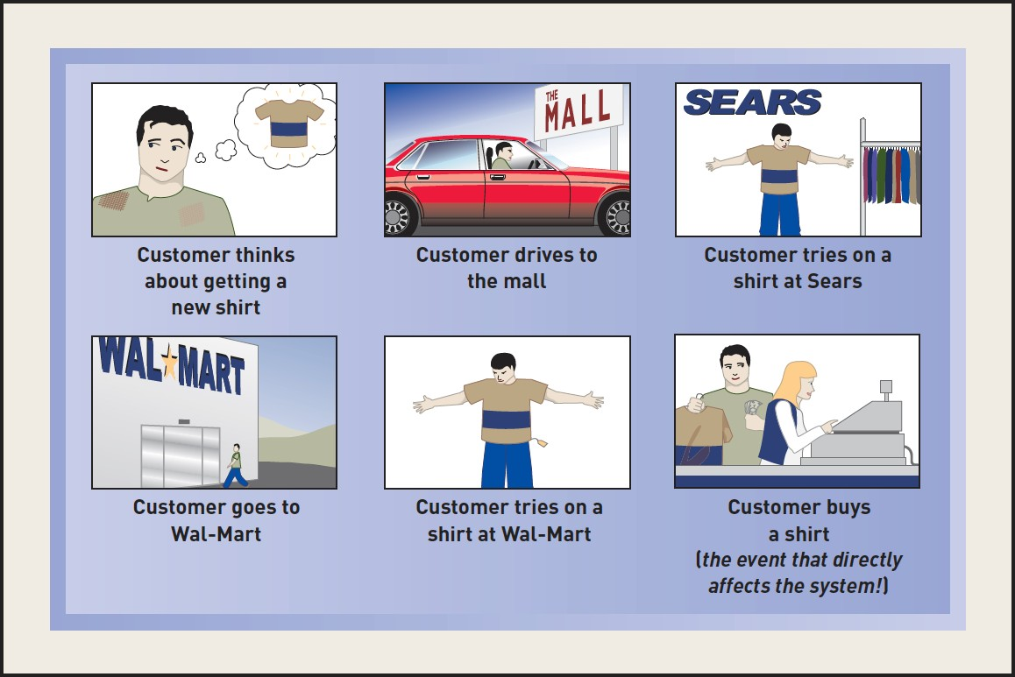
IDENTIFYING EVENTS
Sequence of actions that lead up to only one event affecting the system

Slide 17
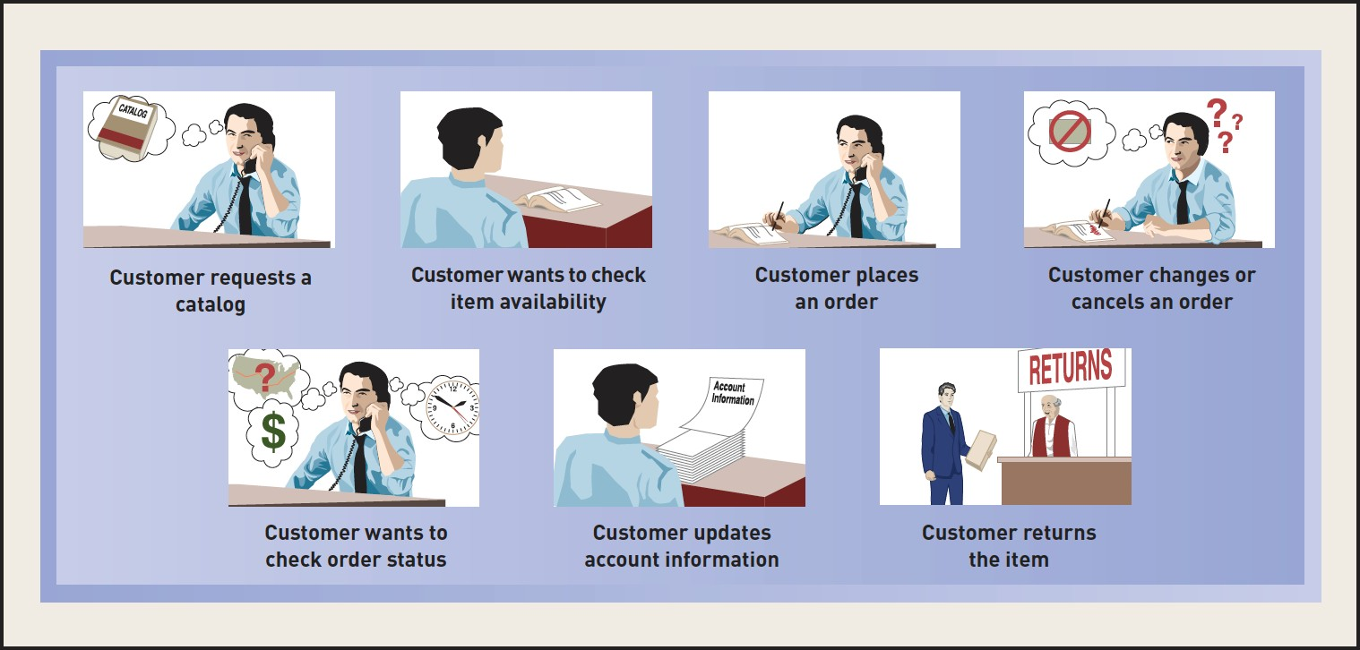
The sequence of “transactions” for one specific customer resulting in many events

Slide 18
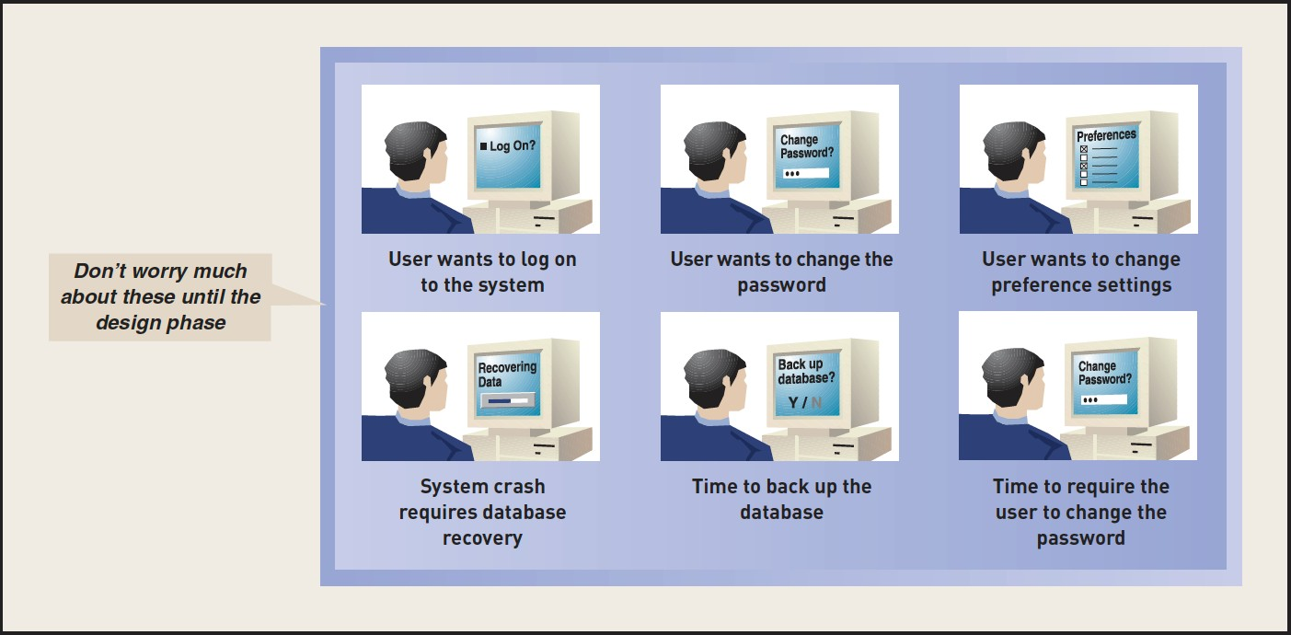
Events deferred until design, ignore these at start of project
System Controls
Checks
Safety procedures
Protection of integrity of system
Technology-dependent Events

Slide 19
Summary of Decomposition Steps
Identify external events that require response from the system
For each event, identify and name a use case
Identify the temporal events that need a system response
For each event, identify and name a use case the system requires
then identify the point in time that triggers the use case
Identify the state events the system might respond to
For each state event, identify and name the use case the system needs and the state change
Assuming perfect technology, check each use case is needed, and ignore system controls for now

Slide 20
Naming events
Should include
agent is named
identify the action
Example
customer places an order

Slide 21
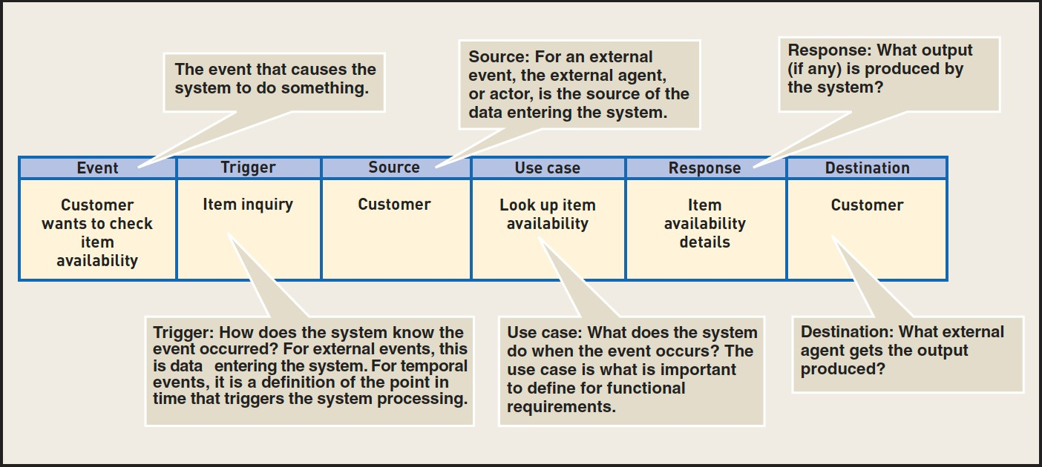
Event table
Use an event table as a catalog of information about the use cases that make up the functional requirements of the system.

Slide 22
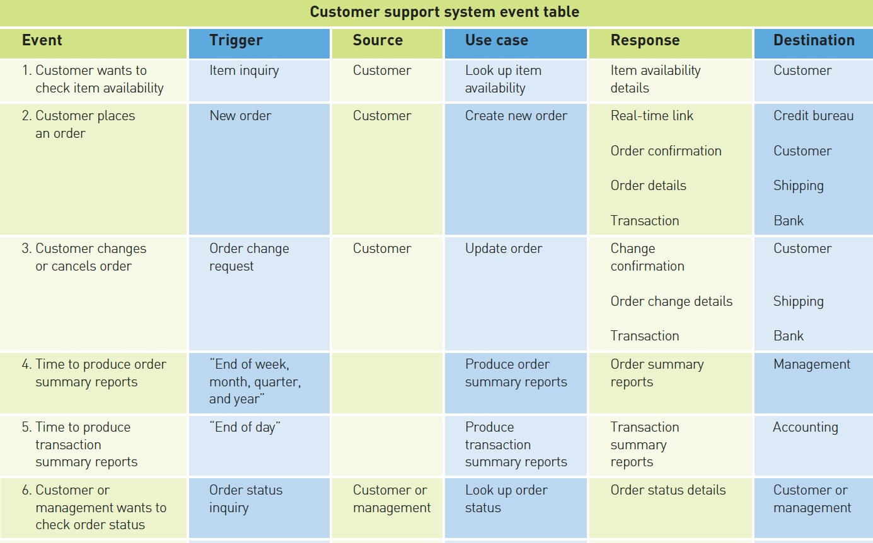
Example: Customer support system event table

Slide 23
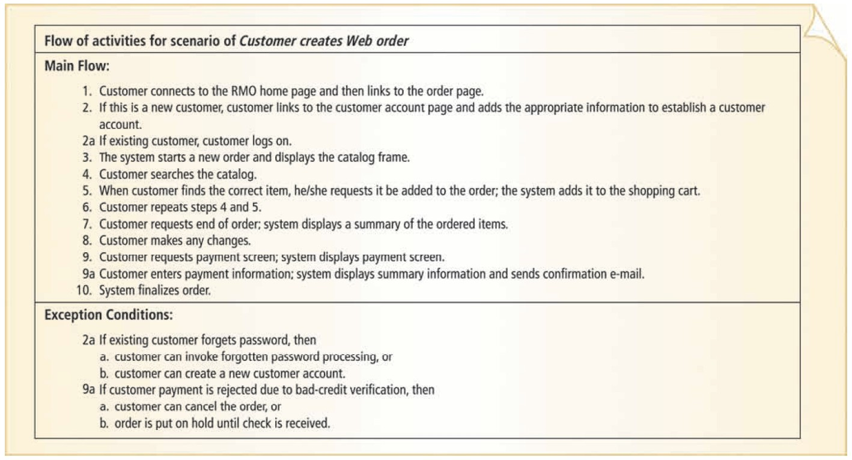
Use case descriptions
Intermediate description of the Web order scenario for Create new order

Slide 24
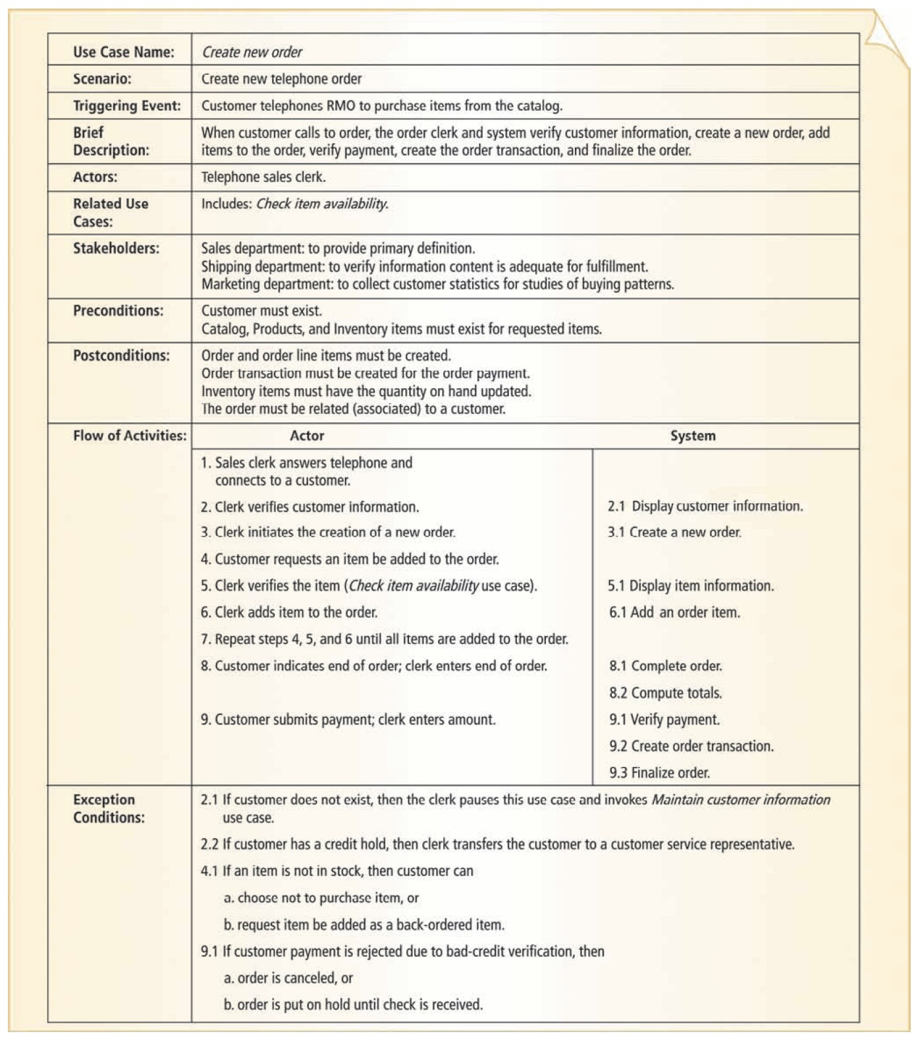
Fully developed description

Slide 26

Thank you for your attention! Q&A

